Slide 1
Does the switch to 5G security require a new SIM card?
Blaura

Slide 2
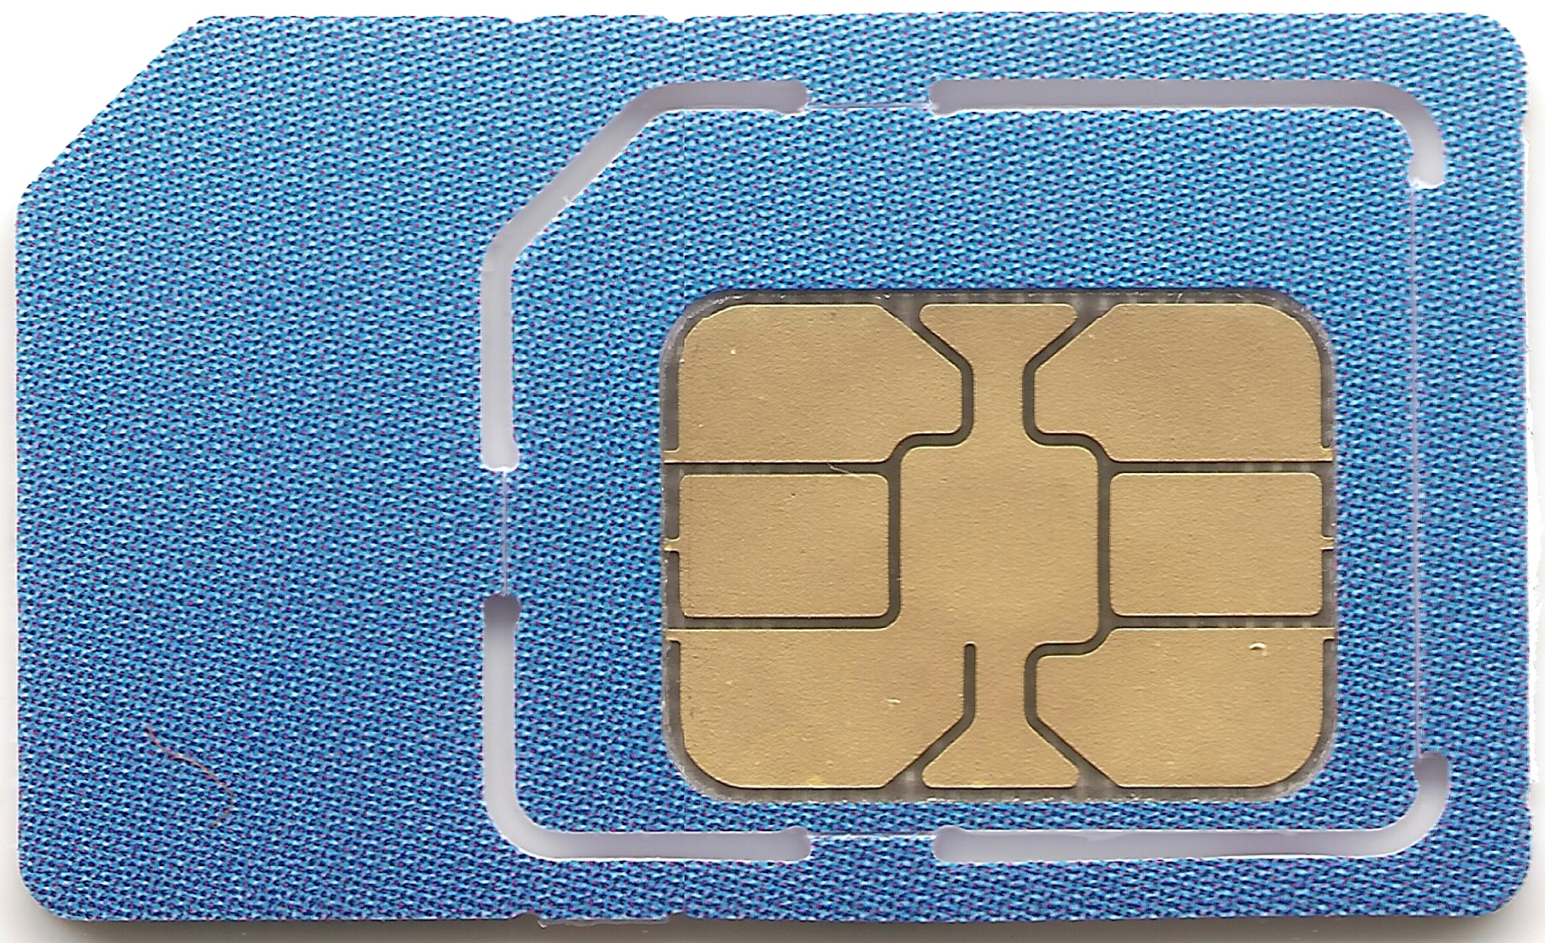
What is a sim card ?
In 2G, the smart card is called the subscriber identity module (SIM) that represents hardware and software together.
3G systems use a newer smart card with software and hardware separated, named Universal SIM (USIM)
We refer to these newer smart cards as Rel 99+ USIM which are compatible with first 3G specifications and afterwards.

Slide 3
Identity and access management (IdAM)
5G provides at least two methods of authentication and key agreement for accessing the network.
The Rel 99+ USIMs that could be used in 4G are still compatible with 5G.
There are compatible because there is no need for a new permanent security key shared between USIMs and the network.

Slide 4
Privacy
5G has introduced significant privacy enhancements
The most important one which is the use of subscription concealed identifier (SUCI).

Slide 5
Conclusion
Rel 99+ USIMs are still compatible to get access to 5G
For subscription permanent identifier (SUPI) privacy, Rel 99+ USIMs can be used
You should rather be interested in the particular features you care about and check if they are enabled or not by the provider

Slide 6
Reference

